Slide 1
Introduction to Energy Systems
Module 4
Climate Change Models
Prepared by: Prof. Amin Ghobeity
Please do not distribute without permission

Slide 2
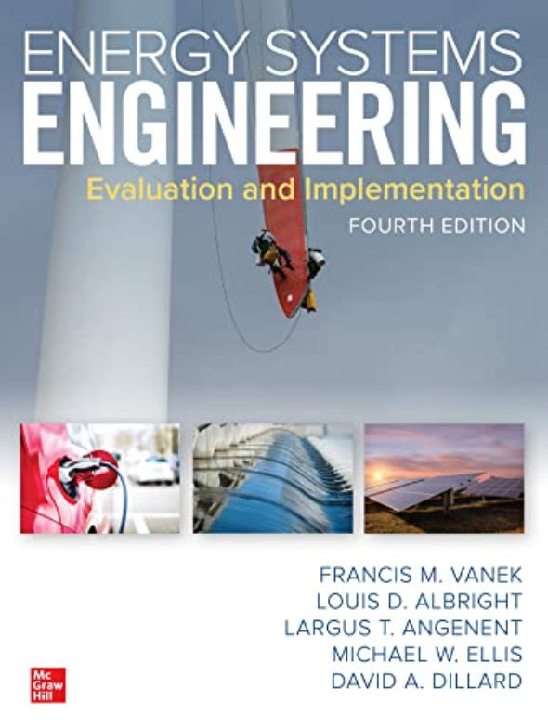
References
Instructor Notes
Energy Systems Engineering: Evaluation and Implementation, 4th Ed.
McGraw-Hill, New York, 2016
Chapter 4

Slide 3
Weather vs. Climate
Weather – atmospheric conditions
Temperature, pressure, wind speed, and moisture level
Period of hours or days
Climate – average weather conditions over a long period of time
Period of decades or centuries

Slide 4
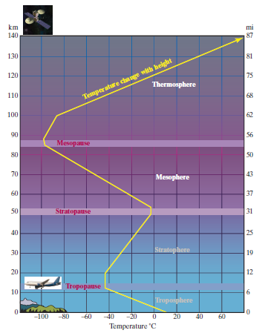
Layers of the Atmosphere
Troposphere
Important in shaping our weather
Air temperature decreases with altitude
Almost all water vapor is contained in this layer
Stratosphere
Air temperature increases with altitude
Ozone in this region absorbs UV radiation
Air is very dry and thin (~1000 times thinner than air at sea level (jet aircrafts fly at this layer because of that)
Mesosphere
Air temperature decreases with altitude
Small amount of ozone
Thermosphere
Air temperature increases with altitude
Oxygen molecules absorb solar radiation

Slide 5
Greenhouse Gases
Greenhouse gases
Gases that cause the gradual warming of the Earth’s atmosphere
Carbon dioxide (CO₂) – 80% of man-made greenhouse gas emissions
Methane (CH₄)
  Fuel and many manufacturing uses
Nitrous oxide (N₂O)
  Many applications (medical, oxidizer, combustion engine of racing cars, aircraft engines)
Hydrofluorocarbons (HFC_{s})
  Refrigerants
Perfluorocarbons (PFC_{s})
  Metallurgical and refining, semiconductor manufacturing
Sulfur hexafluoride (SF₆)
  Electric power industry, semiconductor manufacturing

Slide 6
Mathematical Modelling of Climate Change
Heat transfer between sun-earth (black-body radiation)
Earth temperature in absence of global warming
Relationship between wavelength, energy flux, and absorption
Contribution of specific wavelength and gases to greenhouse effect
A model of earth-absorption system
  Single layer climate model with representative energy flows in W/m²

Slide 7
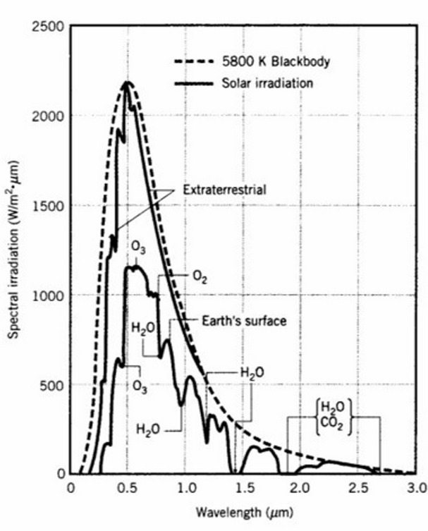

Spectral Emissivity
The energy emitted from black-body radiation is the sum of energy of all waves emitted by the body, across all wavelengths
Total Energy is the integral of spectral irradiation over the entire wavelength
At a given wavelength, λ, the energy emitted from the sun at that wavelength, F_{BB}(λ), can be calculated from:

Slide 8
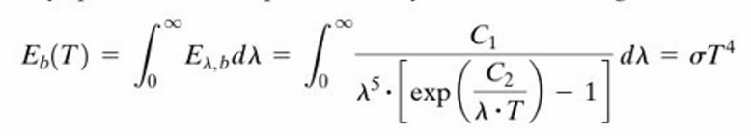

Wavelength, energy flux, absorption
At a given wavelength, λ, the energy emitted from the sun at that wavelength, F_{BB}(λ), can be calculated from equation given in previous slide.
The energy emitted from black-body radiation is the sum of energy of all waves emitted by the body, across all wavelengths
Note that temperature determines the wavelength at which peak black-body transmission of energy will occur.
Total energy emitted:
Wavelength at which emitted energy is at its peak:

Slide 9
Example
Assuming 5770 K as the average observed surface temperature of the sun, determine at which wavelength the emitted energy peaks. What is the intensity in W/m² at this wavelength. Compare these values with spectral emissivity of the sun

Slide 10
Sun-Earth Geometric Distances
Sun’s radius is approximately 700,000 km
Earth radius is approximately 6,400 km
Distance between earth and sun is approximately 150,000,000 km
Sun’s energy loses intensity (W/m²) based on this this distance. This leads to the definition of solar constant

Slide 11


Solar Constant
Energy flux (W/m²) of sun energy on earth surface is known as solar constant S₀
Black body radiation:
σ is Stefan-Boltzmann constant, σ =5.678x10-8 W/(m²k⁴)
Given sun’s temperature, distance from earth to sun:
S₀ = 1368 W/m² is know as the solar constant. Values of 1368-1372 W/m² are reported in the literature

Slide 12
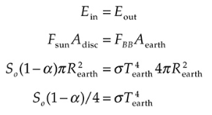
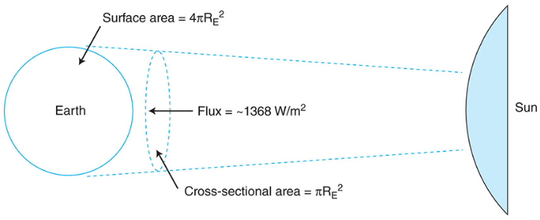


Earth Temperature
Earth temperature can be estimated using a simplified energy balance on earth
Where α is the fraction of light reflected back from the earth, known as albedo. Assuming α =0.3:
This value represents the average temperature of a planet orbiting our sun at the same radius as the Earth and with the same albedo, but with no atmosphere.

Slide 13
Contribution of Specific Wavelengths and Gases to Greenhouse Effect
Consider two factors:
  (1) the ability of different molecules to absorb radiation at different wavelengths
  (2) the extent to which radiation is already absorbed by preexisting levels of gases when concentration of some gases increases.
CO₂ molecule has a peak absorptive capacity in the range from approximately 12 to 14 μm, which coincides with the peaking of the energy flux based on the Earth’s black-body temperature (see next slide)
H₂O has high absorption elsewhere on the spectrum, including longer wavelengths (>20 μm) and some of the incoming shorter waves from the sun.
Increasing the amount of CO₂ in the atmosphere increases the absorption percent, leading to a warming of the average temperature of both the atmosphere and the Earth’s surface.

Slide 14
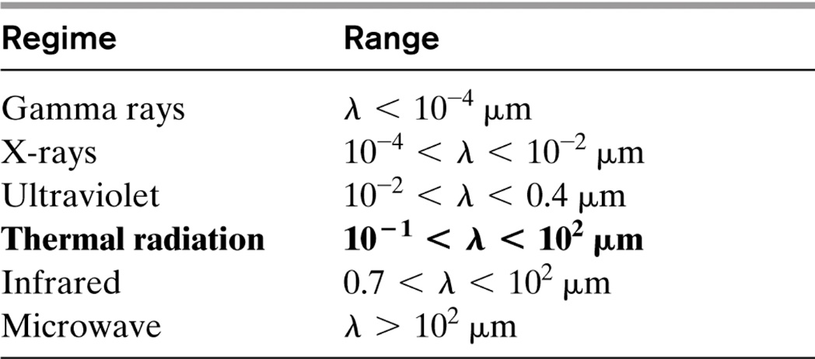
Solar Irradiance
As the solar flux passes through the atmosphere, it is attenuated by the presence of oxygen (O₂), ozone (O₃), water vapor (H₂O), and carbon dioxide (CO₂). As a result, the solar flux at the Earth’s surface is significantly less than the extraterrestrial solar flux.
As the solar flux traverses the atmosphere, both the magnitude and directional distributions are altered due to absorption and scattering.

Slide 15
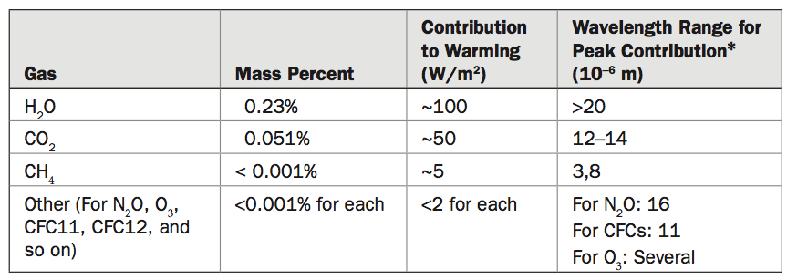
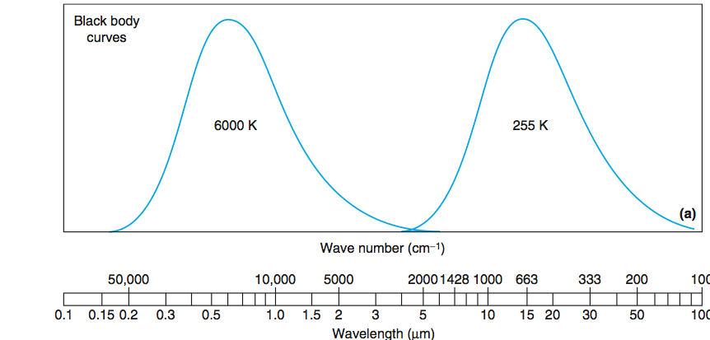
CO₂ and H₂O Contribution to Global Warming
the percent change in atmospheric water will not be as great as that of CO2, and hence the effect of changing concentration of water will not be as large.
Distribution of relative energy of emission from sun and Earth black bodies by wavelength

Slide 16
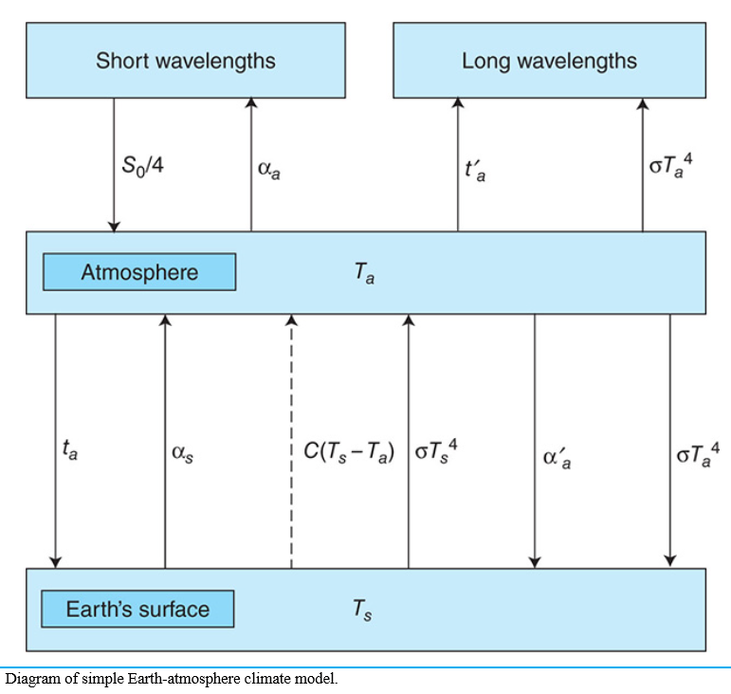
Simplified Earth/Atmosphere Temperature Models
The goal of these models is estimating temperature rise on earth’s surface considering various heat transfer mechanisms between sun, atmosphere, and earth’s surface
The model includes significant simplifications, but still provides valuable qualitative results for investigating various scenarios.

Slide 17
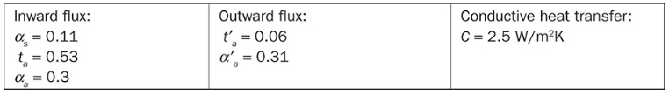
A model of earth-absorption system
The simplifying assumptions for this model are as follows.
  First, we are considering a one-dimensional model where energy is transferred along a line from space through the atmosphere to the Earth’s surface and back out to space; the lateral transfer of energy between adjacent areas of the surface or atmosphere is not included.
  Second, the atmosphere is considered to have uniform average temperature Ta, and the Earth’s surface is considered to have uniform average temperature Ts.
  Third, only radiation and conduction are considered; in the interest of simplicity, convection between surface and atmosphere is not included.
  The goal of the model is to calculate equilibrium temperatures of the Earth’s surface and atmosphere, respectively, using an energy balance equation for each.

Slide 18
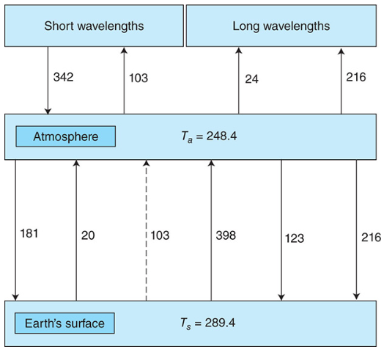
Model Predictions
Mathematical model can be solved to get earth surface and atmospheric temperature assuming input parameters
The resulting outputs from the solver are Ts = 289.4 K, Ta = 248.4 K.
  Note that due to the simplicity of the model, the results do not exactly reproduce the observed surface value of 288 K and observed value in the upper atmosphere of 255 K

Slide 19
Earth Energy Balance
The four terms can be explained in the following way:
  Incoming energy flux from the sun: The amount transmitted by the atmosphere, after taking out the amount reflected by the surface
  Conductive heat transfer: Energy transferred outward due to the temperature difference between surface and atmosphere
  Radiative heat transfer outward: Black-body radiation outward, after taking out the amount reflected back to the surface by the atmosphere
  Radiative heat transfer inward: From atmosphere to surface

Slide 20
Atmosphere Energy Balance
The four terms can be explained in the following way:
  Incoming energy flux from solar gain: The amount retained by the atmosphere, after taking out the amount reflected by the atmosphere back to space, and also the amount transmitted to the surface, of which a portion is reflected back to the atmosphere
  Conductive heat transfer: To atmosphere from surface
  Radiative heat transfer inward from Earth’s surface: Radiation inward, after taking out the amount reflected back to the surface and transmitted to space
  Radiative heat transfer outward: From atmosphere both to surface and to space

Slide 21
Example
Use the model presented to model the effect of an ice age.
  Suppose the combination of increased ice on the surface of the Earth and decreased CO2 in the atmosphere changes the parameters in the model as follows: α_s = 0.15, t’_a = 0.12, α’_a = 0.23. All other parameters are unchanged. What are the new values of T_{a} and T_{s}?
Short Answer: T_{s} = 278.7°C, T_{a} = 243.1°C
Complete solution is next slide. Try the problem before reviewing the solution next slide

Slide 22
Example – Solution
The approach to this problem is to use a solver model and find values of T_{a} and T_{s} that satisfy the condition that the heat balance equation for both the atmosphere and surface layers balances. The values that satisfy this requirement are T_{a} = 243.1 K and T_{s} = 278.7 K.
This can be verified as follows: the general equations for the model are:
Substituting new values for parameters and the correct values for temperature gives:
This concludes the verification.

Slide 23
Summary
Human use of energy emits large volumes of CO₂ to the atmosphere due to our heavy dependence on fossil fuels as an energy source.
Energy conversion is the largest emitter of CO₂ in the world.
To date, research strongly suggests that, since CO₂ is such a potent greenhouse gas, doubling or tripling its atmospheric concentration will lead to an increase in global average temperature that can have severe negative repercussions on local average temperature, amount of precipitation, frequency and intensity of extreme weather events, and other concerns.
Other anthropogenic GHGs such as methane (CH₄), nitrous oxide (N₂O), and chlorofluorocarbons (CFCs) play a role as well. However, the effect is not as significant as CO₂.
Simplified mathematical model for climate change exist and used for qualitative evaluation of the climate change, earth and atmospheric temperature

